Slide 1

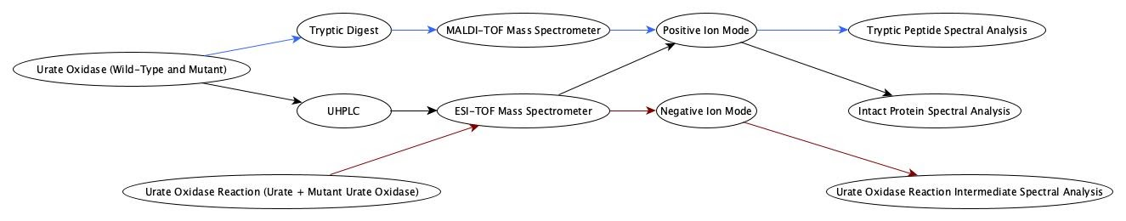
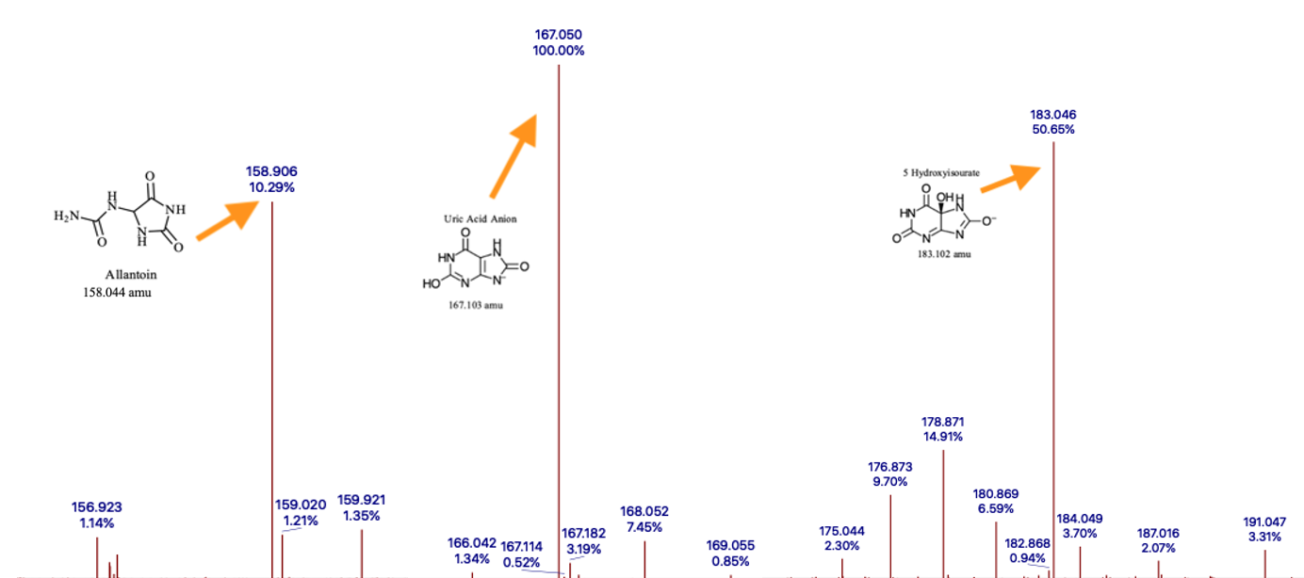
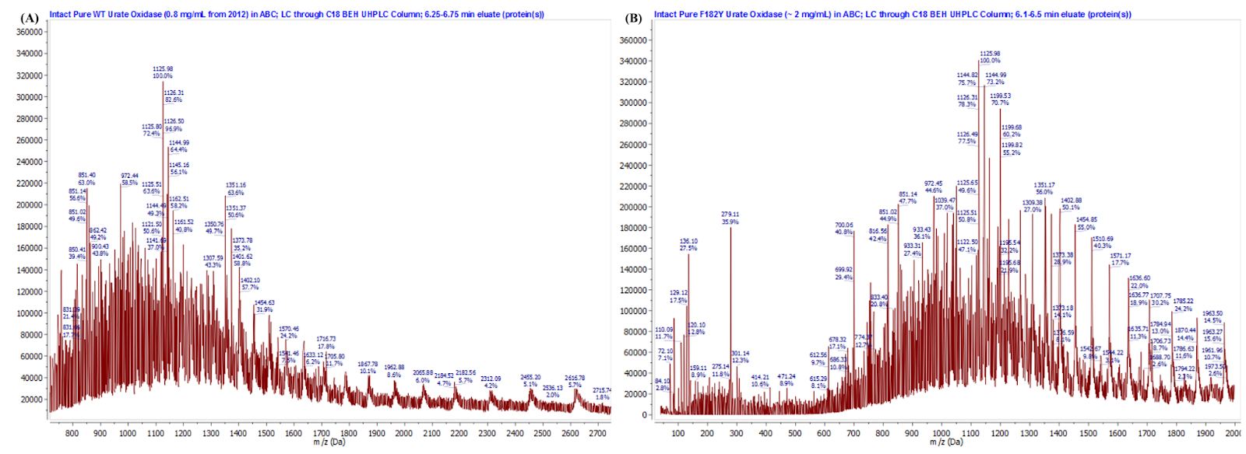
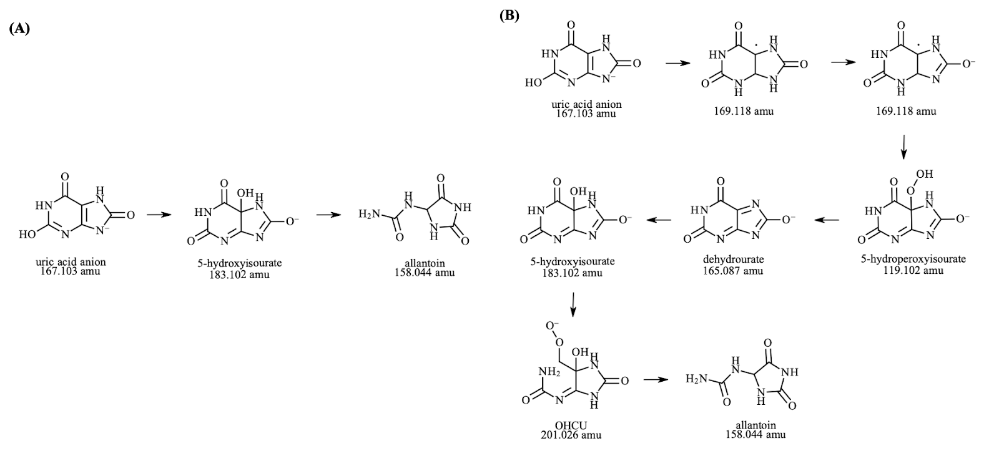
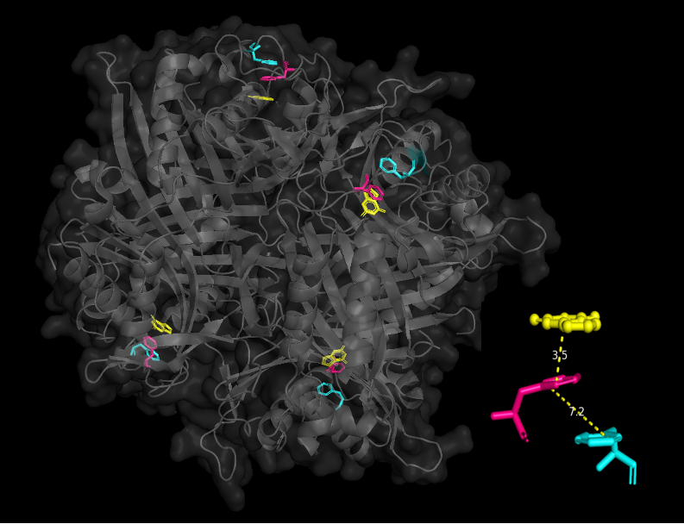
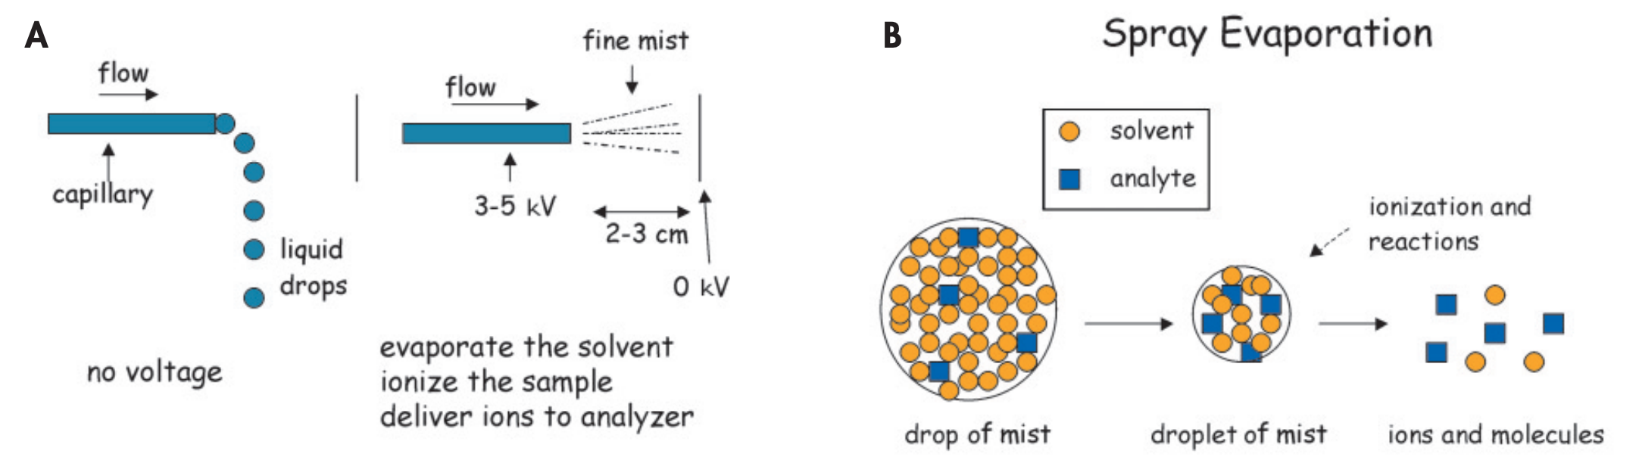
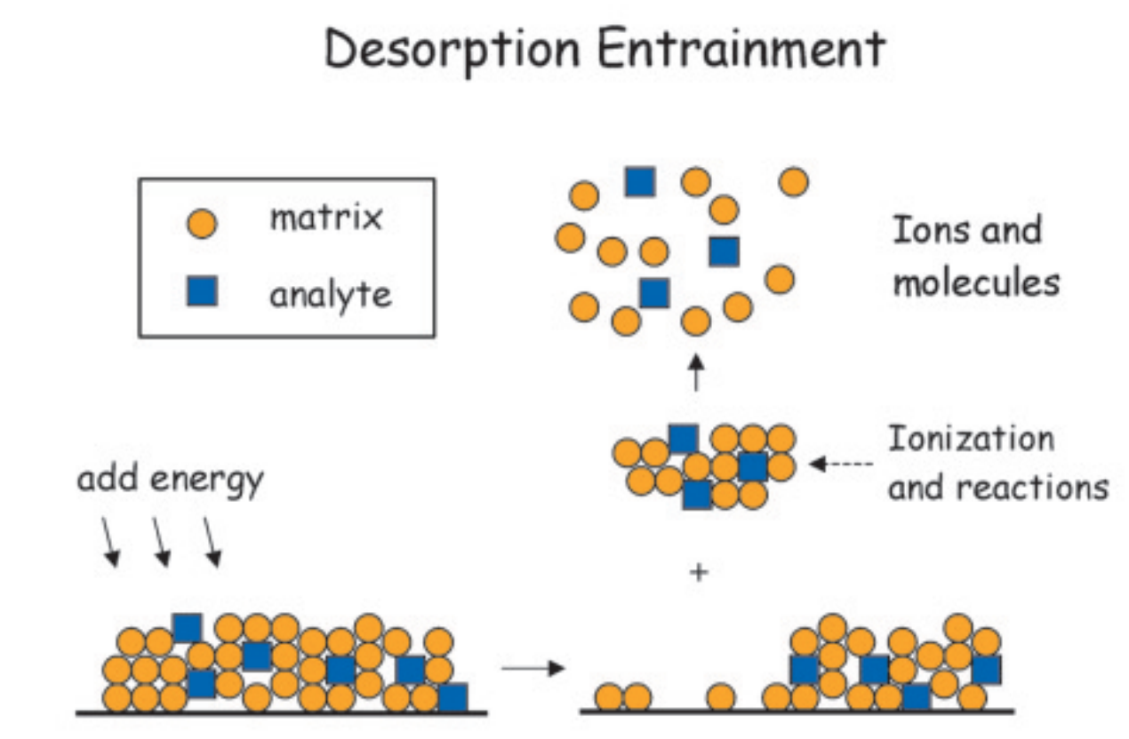
Mass Spectrometry Analysis of Urate Oxidase
Shane Abbley¹, Niko Chapman¹, Joseph Grass¹, Danea Palmer¹
¹Department of Chemistry and Biochemistry, University of California Santa Barbara, Santa Barbara, California
Abstract
Methods
Results
Mass spectrometry is a powerful technique for determining molecular structures and analyzing proteins. In this study, we compared two mass spectrometry techniques in their ability to provide information about the urate oxidase enzyme: matrix-assisted laser desorption ionization (MALDI) and electrospray ionization (ESI). Utilizing the inline C18 UHPLC column for pre-separation, collection of higher-resolution ESI-TOF spectra for both intact wild-type and F182Y mutant urate oxidase proteins allowed for the relative determination of the mass difference via charge deconvolution in MNova. We also performed a digest of the urate oxidase protein using trypsin and demonstrated how both MALDI and ESI data can be used to verify the presence of a single point mutation in urate oxidase. ESI-TOF was then applied to characterize the reaction catalyzed by urate oxidase. This allowed for confirmation of the reaction pathway in which urate is first converted to 5-hydroxyisourate, followed by the spontaneous decomposition to allantoin.
Z
Experiment 3: Analysis of Reaction Intermediates
This graphic simplifies the three experiments we performed into a flow chart. Black lines: Experiment 1, Blue lines: Experiment 2, Red lines: Experiment 3.
Results
Experiment 1: Analysis of Intact Urate Oxidase
Background
Figure 6: Intermediates in the urate-to-allantoin pathway and their respective peaks collected by ESI-TOF in negative-ion mode. The peaks for allantoin and 5-hydroxyisourate were obtained from a 27 µM urate solution mixed with 40 µL of F182Y recombinant UOX in ammonium bicarbonate buffer, time of collection after mixture: 4 minutes. The urate monoanion peak was obtained from a blank of 27 µM urate solution in ammonium bicarbonate.
Urate oxidase (uricase; EC 1.7.3.3; UOX) is an enzyme that catalyzes the oxidation of urate via the utilization of molecular oxygen. It is directly involved in the purine degradation pathway of both prokaryotes and eukaryotes. Though the role of urate oxidase differs across kingdoms, urate oxidase facilitates the oxidation of uric acid to the metastable product 5-hydroxyisourate and hydrogen peroxide. 5-hydroxyisourate then degrades to allantoin through subsequent hydrolysis and decarboxylation steps.
Figure 3: ESI-TOF spectra of (A) intact wild-type urate oxidase (B) intact F182Y urate oxidase.
Figure 1: Visualization of the tetrameric form of the wild-type urate oxidase, with the active site residues F182 (cyan) and F179 (pink) highlighted in each active site in complex with the inhibitor 8-azaxanthine (yellow) (PDB: 1J2G). The bottom right of the figure depicts the pi-pi stacking interactions between both phenylalanine residues, as well as the pi-stacking stabilization of active site-bound 8-azaxanthine.
(A)
(B)
Peak maximum: 39,273.7 amu
Avg molecular weight: 39,273.5 amu
Peak maximum: 39,251.2 amu
Avg molecular weight: 39,290.3 amu
Figure 7: (A) Urate-to-allantoin pathway deduced from ESI-TOF spectral analysis. (B) Proposed pathway for urate-to-allantoin pathway, modified from the schematics proposed previously by Kahn and Tipton (1998) and Sarma, Serfozo, Kahn, and Tipton (1999).^{2,3}
Conclusion
Verification of single point mutations in urate oxidase, as well as the identification of intermediates in said enzyme-catalyzed reaction can be accomplished via the utilization of two mild-ionization spectrometry techniques. For the identification of our point mutation, MALDI-TOF spectrometry was used to compare the tryptic digest of the wild-type and F182Y variants of urate oxidase. This experiment yielded more conclusive evidence to support the presence of the F182Y mutation than our intact ESI-TOF spectrometry experiment. For identification of the reaction intermediates of the urate-to-allantoin pathway, collection of negative-ion mode spectra allowed for the determination of a singular intermediate, 5-hydroxyisourate. Though this is not the only expected intermediate, simple modifications to the acquisition time and/or the addition of a reducing agent such as DTT could potentially allow for the identification and confirmation of a handful of short-lived intermediates.
A convenient way to analyze the urate oxidase protein and the urate oxidase reaction is by using mass spectrometry.
Figure 4: Charge deconvoluted ESI-TOF spectra of (A) intact wild-type urate oxidase (B) intact F182Y urate oxidase.
(A)
(B)
(C)
Experiment 2: Analysis of Tryptic Digest Products
(A)
(B)
Figure 2: The Electrospray Ionization (ESI) technique, represented by the following processes: (A) The depiction of the electrospray process. (B) The depiction of the solvent-analyte droplets, which are subsequently destabilized due to Coulombic repulsion interactions of charged analyte molecules. Portion (C) depicts the basic process utilized for Matrix-Assisted Laser Desorption/Ionization (MALDI) spectrometry (Credit: Vestling, 2003).²
VSGNSFVGYIR
References
Goals
VSGNSFVGFIR
1) Bishop, J.; Kahn, D. K.; Parsons, D. S. Theory Manual: Biophysical and Bioanalytical Laboratory, 112L, Department of Chemistry and Biochemistry University of California, Santa Barbara (2021), 101.
2) Kahn, K.; Tipton, P. A. Spectroscopic Characterization of Intermediates in the Urate Oxidase Reaction, Biochemistry (1998), 37, 11651–11659.
3) Sarma, A. D.; Serfozo, P.; Kahn, K.; Tipton, P. A. Identification and Purification of Hydroxyisourate Hydrolase, a Novel Ureide-metabolizing Enzyme *, Journal of Biological Chemistry (1999), 274, 33863–33865. 4) Nayab, A.; Moududee, S. A.; Shi, Y.; Jiang, Y.; Gong, Q. Crystal Structure of Urate Oxidase from Bacillus Subtilis 168, Crystallogr. Rep. (2019), 64, 1126–1133. 5) Vestling, M. M. Using Mass Spectrometry for Proteins, J. Chem. Educ. (2003), 80, 122.
The first goal of this project was to identify whether a single point mutation in the urate oxidase enzyme was generated successfully. The second goal was to identify the reaction intermediates of the urate oxidase catalyzed reaction.
Figure 5: (A) Wild-type urate oxidase: arrow shows peak for VSGNSFVGFIR fragment at m/z 1182.585 (B) F182Y mutant urate oxidase: arrow shows the peak for VSGNSFVGYIR fragment at m/z 1198.99.
Notes:
D

